Slide 1
Backchannel with WebChat control
Notes:
The backchannel mechanism allows a client app and the bot to exchange information that is invisible to the user. Examples of this could be from requesting the client's time zone to reading a GPS location or what the user is doing on a web page. The bot can even guide the user by automatically filling out parts of a web form and so on. The backchannel closes the gap between JavaScript client apps and bots. This mechanism is implemented by using the Direct Line API, which allows activities to be sent back and forth between the client and the bot.

Slide 2
Bot Framework Channels
Skype
Slack
Facebook
Skype for Business
Cortana
Microsoft Teams
Kik
Bing

Slide 3
What happens if you just want to embed a bot in a website?
Enter WebChat
Embeddable web control
Available via CDN
Customizable
Written in TypeScript
OSS
GitHub

Slide 4
Implementing WebChat

Slide 5
Host-to-WebChat communications
Truly embedded experience
Respond to page updates
Share a data store
Guided human support

Slide 6
Behind the scenes with WebChat
Uses Direct Line
Direct communication with a registered bot
Credentials are required
Could use Direct Line to create your own channel
Access additional types of activities

Slide 7
Bot Framework activity types
message
typing
endOfConversation
event
Not all channels or clients support all activities

Slide 8
Architecture
Host
JavaScript
Direct
Line
(shared)
WebChat

Slide 9
Basic structure
WebChat ignores event activity
Add JavaScript code to host
Subscribe to event activity
Send event activities
Add code to bot to send/receive event activities

Slide 10
RxJS basics
http://reactivex.io/rxjs/
Implements the Observable pattern
LINQ for JavaScript?
Common commands
filter
Subscribe

Slide 11
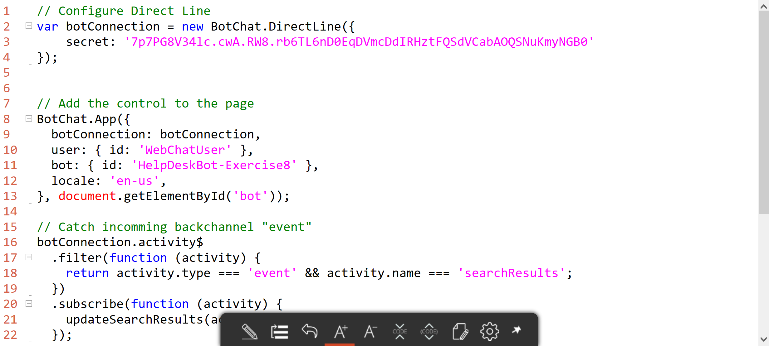
The JavaScript code

Slide 12
Bringing it all together

Slide 13
Your turn
Update your bot to:
Allow messages to be sent from a hosting web page to the user

